Slide 1





ML PROJECT
ETHEREUM PRICE FORECASTING

Slide 2

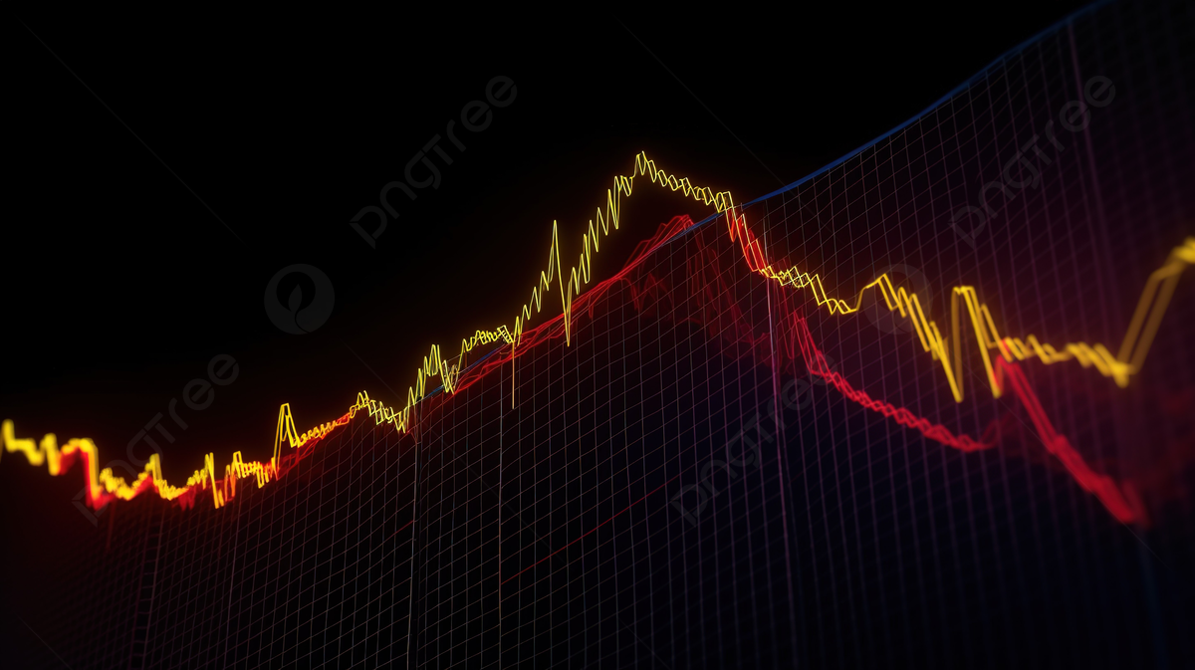
CONTENT
01
02
03
04
Dataset Description
Description of the used models
Experiment setup and results
Summary

Slide 3


DATASET DESCRIPTION
we acquired data from Kaggle, a prominent platform for data science datasets.
The dataset comprises two distinct files—one containing Ethereum price data and the other featuring labeled crypto news data.
The Ethereum price dataset provides historical information, while the labeled crypto news dataset includes sentiment analysis labels for the news related to cryptocurrency.

Slide 4

TIME SERIES FORECASTING MODELS
LSTM
Bi-LSTM
ESN
predicts Ethereum prices well by remembering longterm patterns.
Parameters
Time step: 14
Hidden layer sizes: 64 Loss: MSE Optimizer: Adam
Bi-LSTM sees both past and future trends, improving its ability to predict Ethereum prices.
Parameters
Time step: 14 Hidden layer sizes: 64 Loss: MSE Optimizer: Adam
Echo State Network efficiently learns and predicts Ethereum price changes with a fixed structure.
Parameters
Input size: 1 Reservoir size: 100 Output size: 1 Leak rate: 0.5 Spectral radius: 0.6

Slide 5

CLASSIFICATION MODELS
MLP
SVM
Random Forest
MLP is a flexible learner adept at recognizing complex patterns in data.
Parameters
Activation: tanh Learning rate: 0.0001 Hidden layer sizes: (50, ) Max iteration: 500 Solver: SGD
SVM demonstrates a keen ability to draw clear boundaries between different data points, aiding in effective prediction.
Parameters
C: 1
Kernal: linear
RF is a collaborative model that combines insights from multiple decision trees for perfect predictions
Parameters
Bootstrap: True
Min samples leaf: 4
Min samples split: 2
N estimators: 200

Slide 6
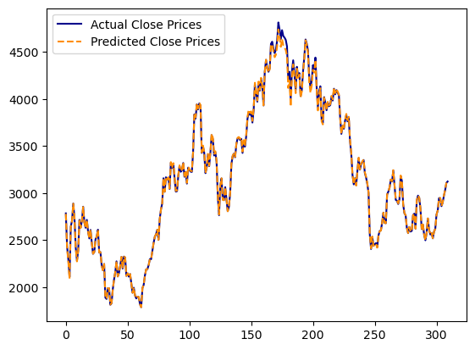
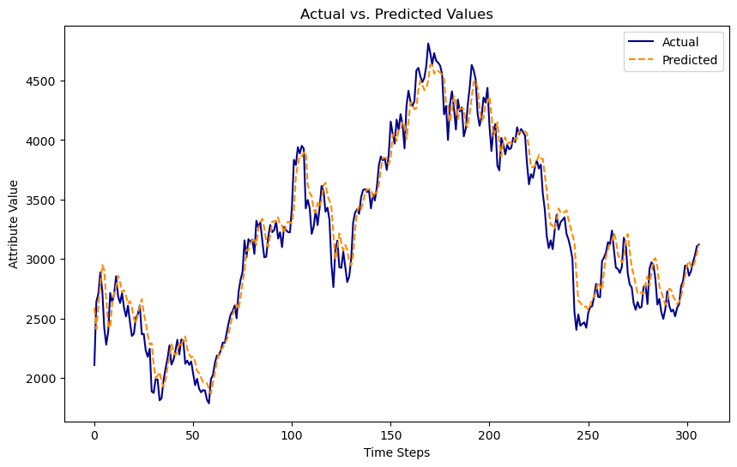
EXPERIMENT SETUP AND RESULTS
TIME SERIES MODELS
The dataset was split into training and testing sets using 80% split. Time series models used a 14-day rolling window for training.
ESN 1
LSTM 2
Bi-LSTM 3
ESN outperformed with MSE of 0.0003.
LSTM outperformed with MSE of 0.017.
Bi-LSTM outperformed with MSE of 0.022.

Slide 7
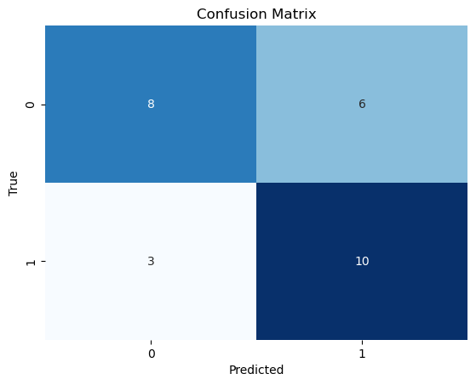
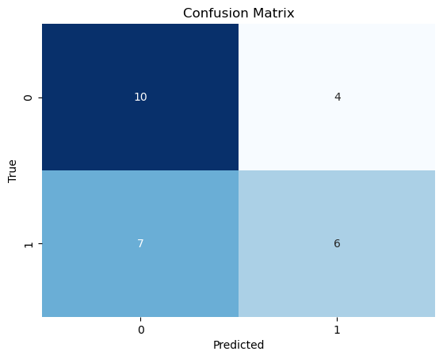
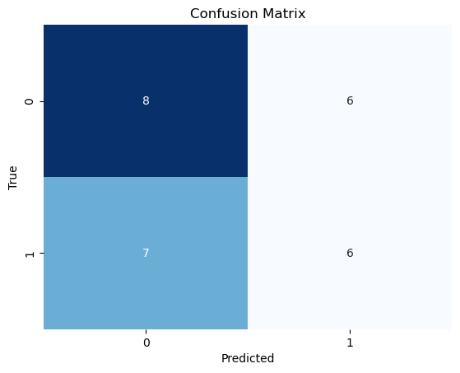
EXPERIMENT SETUP AND RESULTS
TIME SERIES MODELS
The dataset was split into training and testing sets using 80% split. Time series models used a 14-day rolling window for training.
SVM 1
MLP 2
RF 3
SVM outperformed with accuracy of 67%.
MLP outperformed with accuracy of 59%.
Random Forest outperformed with accuracy of 52%.

Slide 8






ADDITIONAL CLASSIFICATION MODELS
01
02
LSTM
Xgboost
LSTM outperformed with accuracy of 72%.
Xgboost outperformed with accuracy of 63%.
03
04
05
ML PROJECT
Catboost
KNN
GaussianNB
Catboost outperformed with accuracy of 60%.
KNN outperformed with accuracy of 60%.
GaussianNB outperformed with accuracy of 55%.

Slide 9

SUMMARY
This project, leveraging Kaggle datasets, integrates LSTM, BiLSTM, ESN, SVM, and MLP models for accurate prediction of Ethereum prices and classification of price movements. The combined models offer valuable insights into cryptocurrency trends, empowering informed decision-making.

